Slide 1



Colorado Solar Sales Booster
Using Data Science to Optimize Solar Panel Sales in Colorado
Professor Busch Course Professor Shane Rodgers Graduate Student
March 11th, 2025
Notes:
Welcome everyone. Today I'm presenting our Colorado Solar Sales Booster project, which uses data science to identify the best areas for solar panel sales across Colorado, helping us target our marketing more effectively.

Slide 2

The Business Challenge
Solar panel sales require significant marketing investment
Traditional geographic targeting often misses key conversion factors
Need to identify areas with both high solar potential AND high conversion likelihood
Goal: Maximize ROI by targeting the right customers in the right locations
Notes:
Solar panel marketing is expensive, and traditional targeting methods often miss key factors. We need to find areas with both high solar potential AND high conversion likelihood. Our goal is to maximize ROI by targeting the right customers in the right locations - considering not just sunlight, but who's likely to buy.

Slide 3

Our Data-Driven Approach
Analyze Multiple Factors:
Solar irradiance (physical potential)
Home ownership rates (decision-making ability)
Property values (investment capacity)
Create a Predictive Model:
Use decision tree algorithm to identify patterns
Calculate combined "Solar Score" to rank ZIP codes
Validate with testing data for accuracy
Notes:
Our data-driven approach analyzes three key factors: solar irradiance (sunlight potential), home ownership rates (who can approve installations), and property values (who can afford them). We've created a decision tree model to identify patterns and developed a "Solar Score" to rank ZIP codes, validated with testing data for accuracy.

Slide 4
The Data Behind Our Analysis
# | ZIP Code | Region | Solar Irradiance (kWh/m²/day) | Home Ownership (%) | Median Home Value ($) | Region Color
1 | 80301 | Front Range | 5.3 | 45% | $300,000 | Yellow
2 | 81301 | Western Slope | 5.7 | 60% | $450,000 | Green
3 | 80210 | Denver Metro | 5.5 | 70% | $600,000 | Blue
4 | 81501 | Western Slope | 5.9 | 75% | $750,000 | Green
5 | 80401 | Front Range | 6.2 | 85% | $900,000 | Yellow
Sample Data Creation:
Generated realistic data for 30 Colorado ZIP codes
Spans three major regions: Denver Metro, Front Range, Western Slope
Includes key variables with realistic distributions
Data Sources:
Solar Irradiance: National Renewable Energy Laboratory (NREL) - https://nsrdb.nrel.gov/
Home Ownership & Property Values: U.S. Census Bureau's American Community Survey - https://www.census.gov/programs-surveys/acs
Property Value Verification: Zillow Home Value Index - https://www.zillow.com/research/data/
Notes:
We're analyzing 30 Colorado ZIP codes across three regions: Denver Metro, Front Range, and Western Slope. Here's a sample of our data. We're looking at solar irradiance (5.3-6.2 kilowatt-hours per square meter per day), home ownership (45-85%), and median home values ($300,000-$900,000). Our data comes from reliable sources: NREL for solar data and the U.S. Census Bureau for demographics.

Slide 5
Calculating Solar Potential
Our Weighted Formula:
50% Solar Irradiance (physical potential)
30% Home Ownership % (decision-making power)
20% Median Home Value (investment capacity)
Formula: Solar_Score = (0.5 * Solar_Irradiance) + (0.3 * Owner_Occupied_% / 100) + (0.2 * Median_Home_Value / 1000000)
Methodology Reference: This approach is based on multi-criteria decision analysis (MCDA) methods commonly used in renewable energy siting. See: "GIS-based multi-criteria decision analysis for solar PV power plant site selection" (Yushchenko et al., 2018)
Similar Resources:
NREL's PVWatts Calculator: https://pvwatts.nrel.gov/
Solar-Estimate's Solar Calculator: https://www.solar-estimate.org/
EIA Studies on Solar Adoption Factors: https://www.eia.gov/analysis/studies/
Notes:
Our Solar Score formula weights three factors: sunlight (50%), home ownership (30%), and home values (20%). For example, an area with 6.0 irradiance, 70% ownership, and $600,000 average home value scores: (0.5×6.0) + (0.3×0.7) + (0.2×0.6) = 3.33. This approach, similar to methods used in renewable energy siting, helps us compare locations on equal footing.

Slide 6
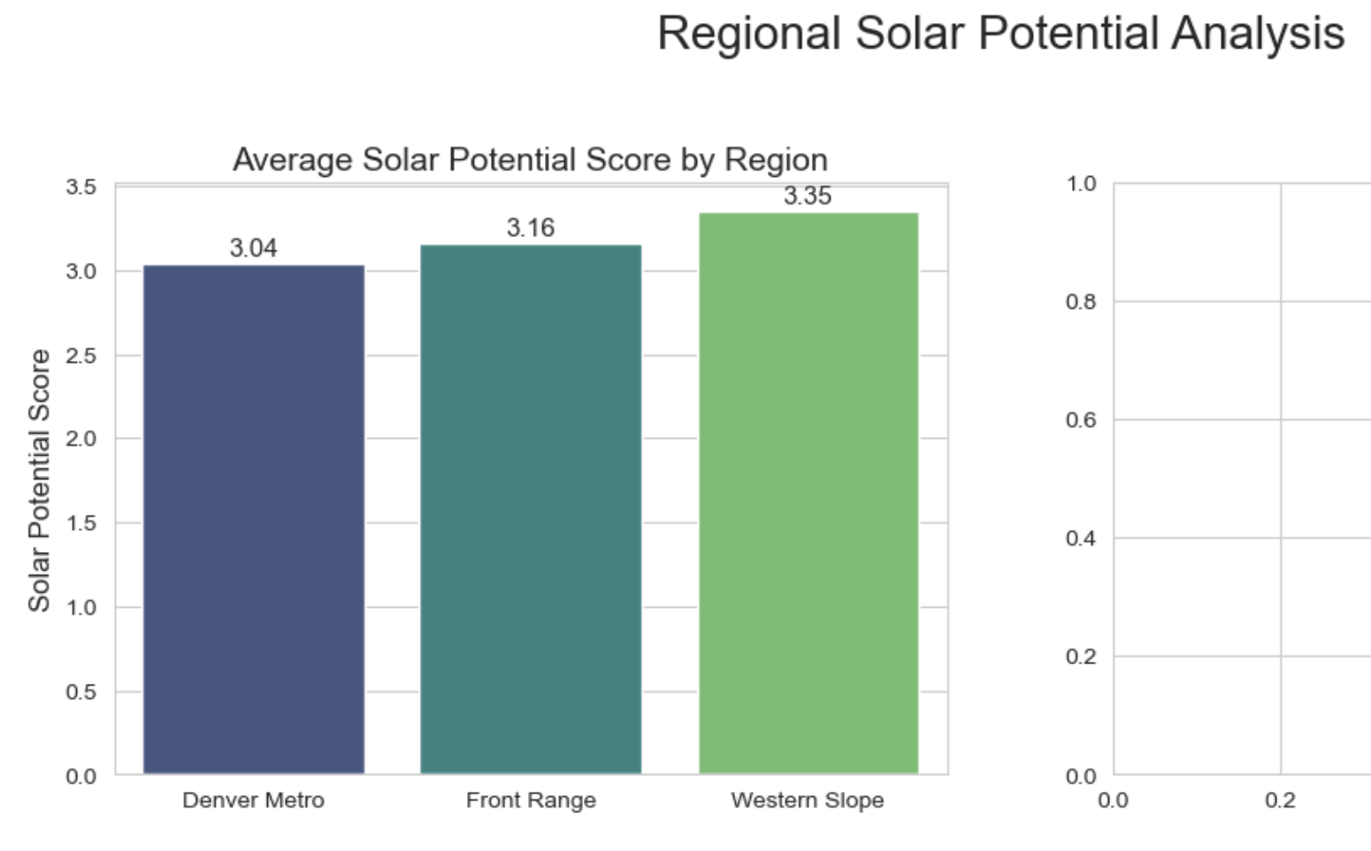
Regional Insights
Key Findings:
Western Slope leads in solar irradiance and home ownership
Denver Metro has highest property values but lowest ownership rates
Front Range shows balanced metrics across all factors
Notes:
Looking at our regional data, we see distinct patterns: Western Slope leads in sunlight and home ownership (about 6.0 kilowatt-hours per square meter per day and 75% ownership); Denver Metro has the highest property values (around $700,000) but lowest ownership (55%); and Front Range shows balanced metrics across all categories. These patterns will guide our targeting strategies.

Slide 7

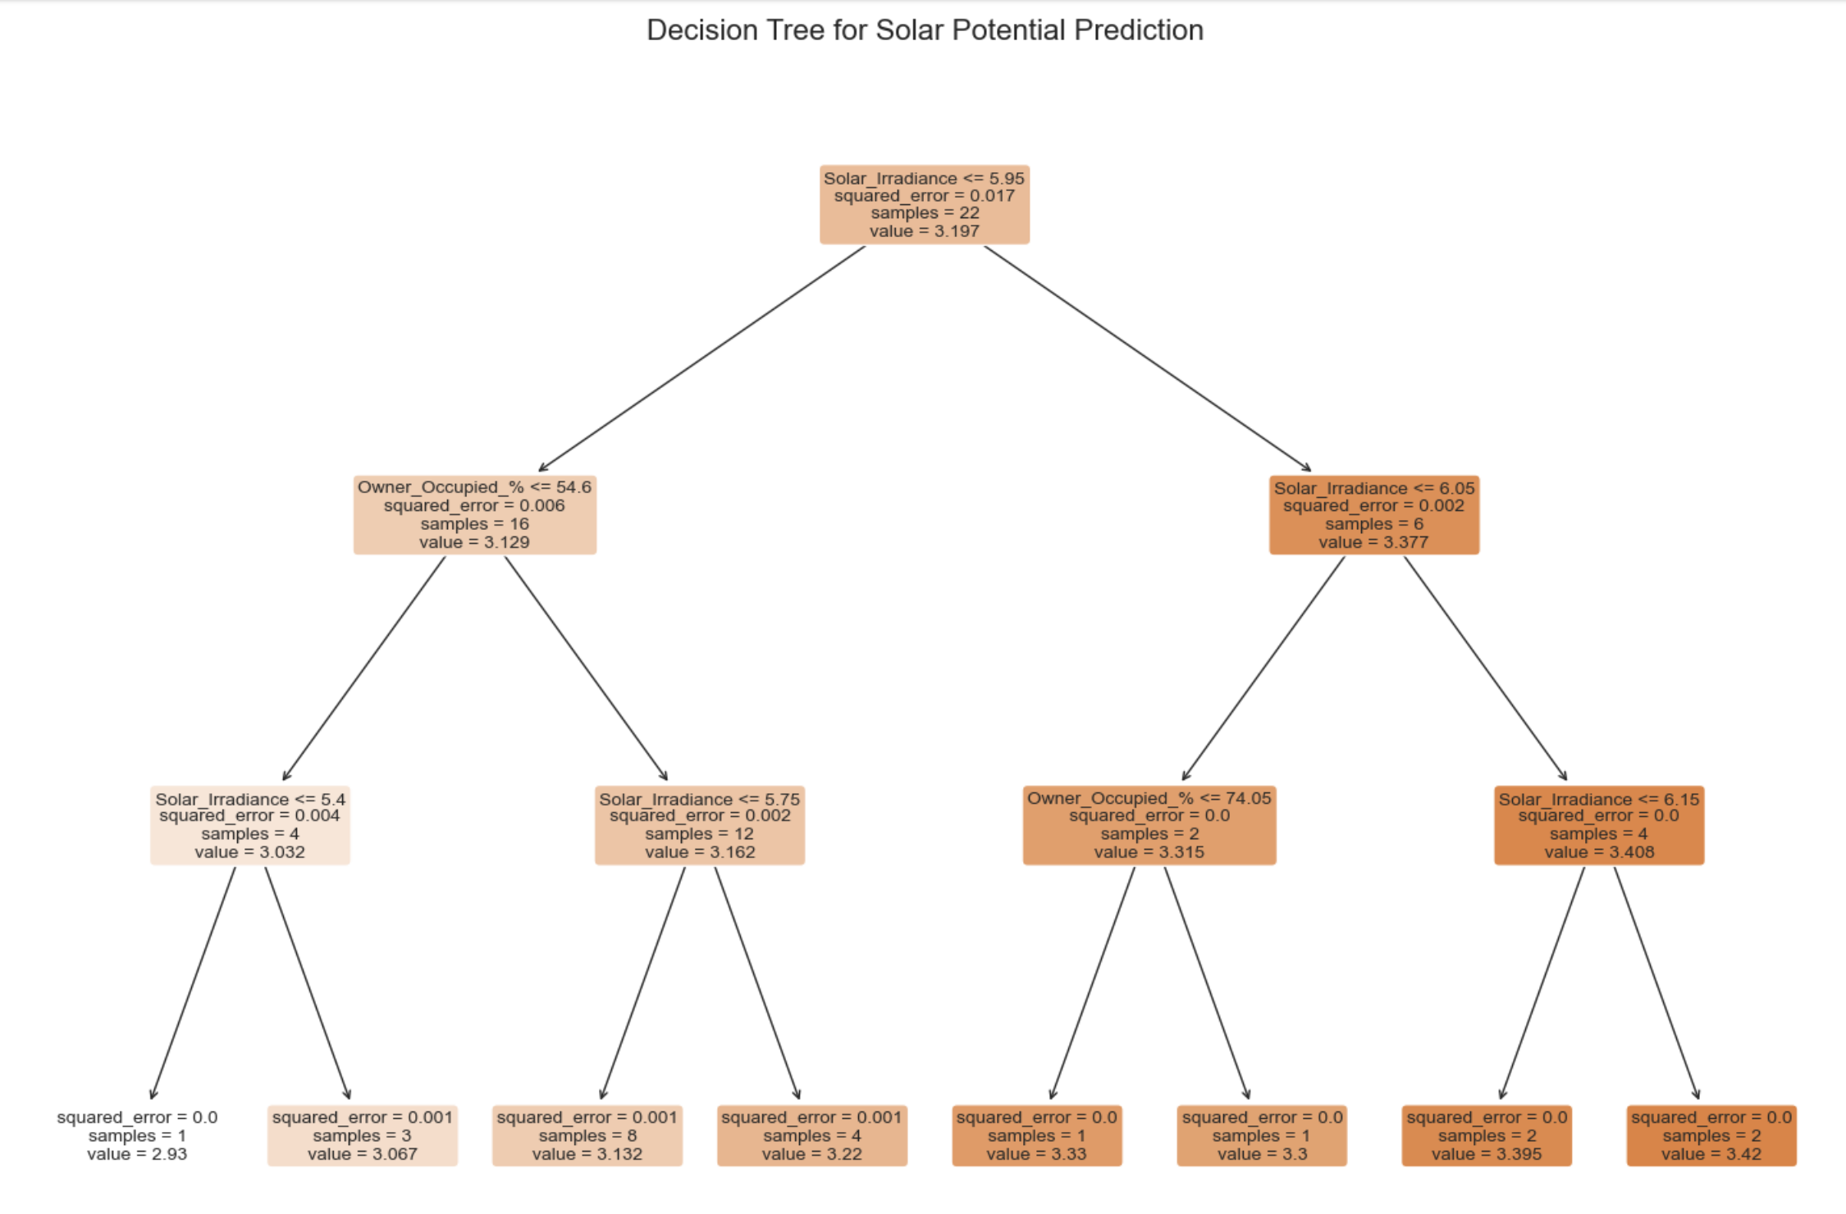
Our Predictive Model
Decision tree model predicts solar potential based on key factors
Model Performance:
Root Mean Squared Error: 0.078 (lower is better!)
R-squared: 0.971 (97.1% accuracy)
Notes:
This decision tree shows how our model makes predictions by answering a series of questions about irradiance, ownership, and home values. Our model performs extremely well with a Root Mean Squared Error of just 0.078 (lower is better) and an R-squared of 97.1% (like getting an A+ on a test). This gives us confidence in our predictions.

Slide 8

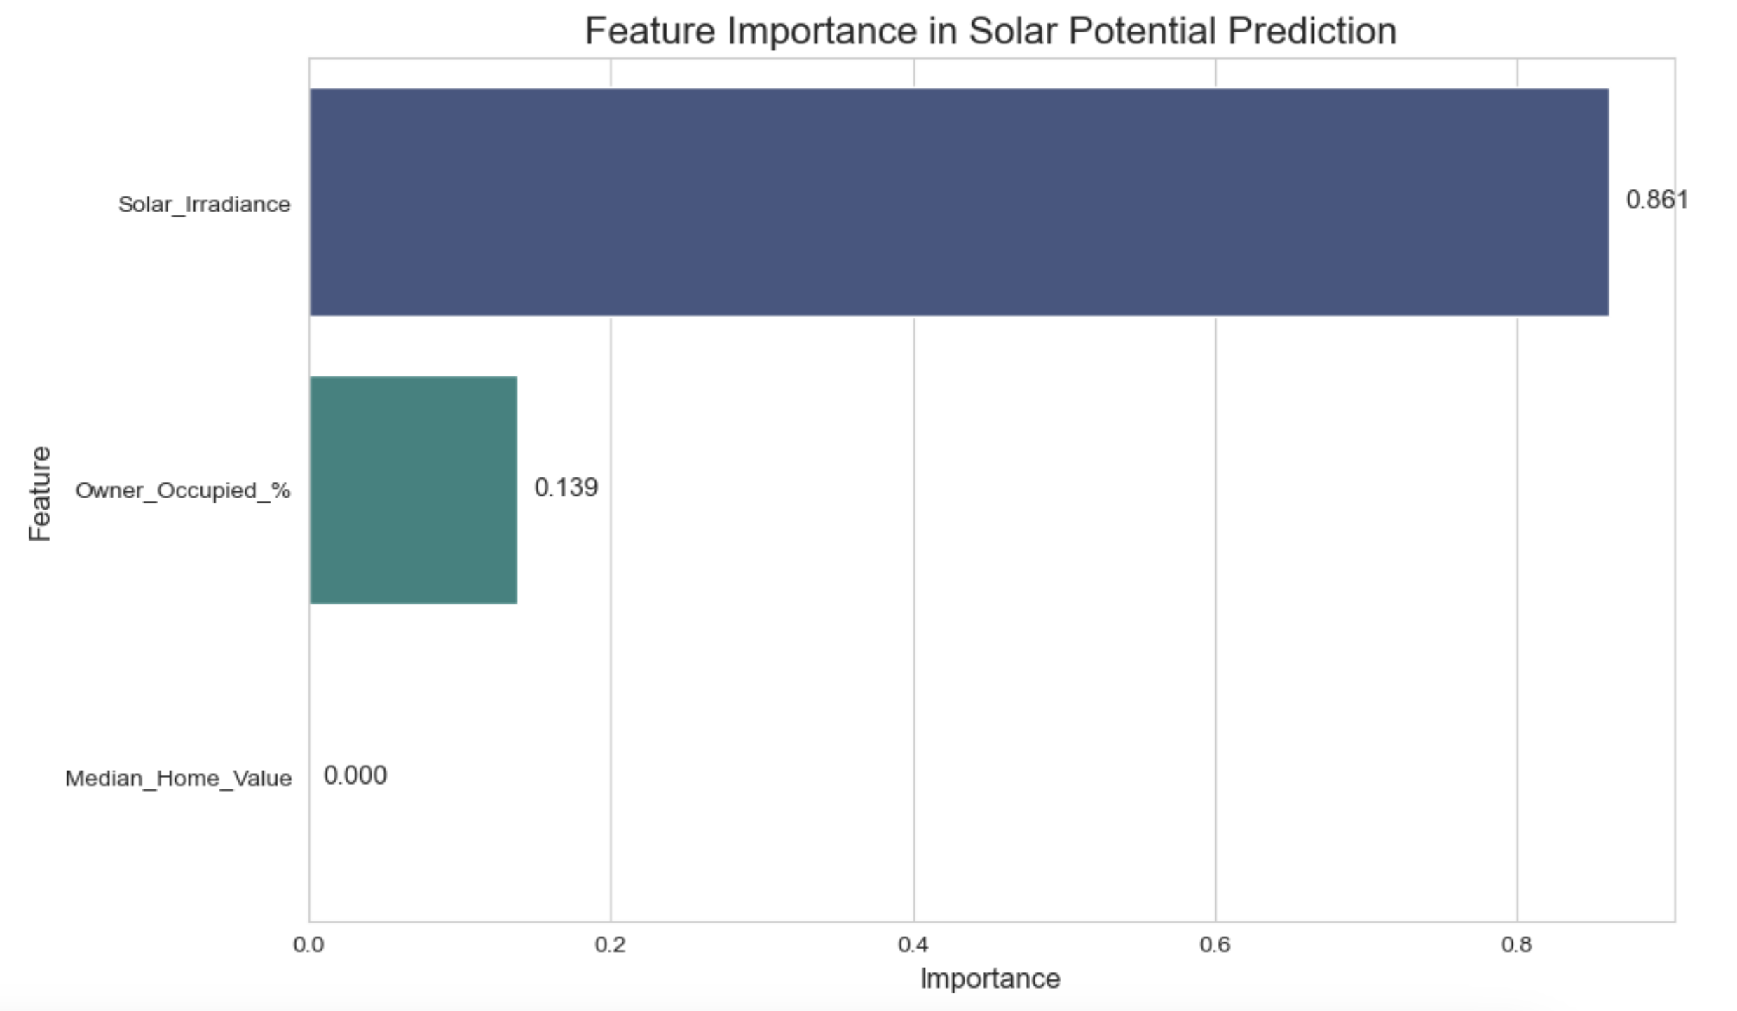
What Factors Matter Most?
Insights:
Solar irradiance remains the dominant factor (~49%)
Home ownership is nearly as important (~31%)
Property values have meaningful but lesser impact (~20%)
This validates our weighting approach in the formula
Notes:
This chart shows which factors matter most for solar sales potential. Sunlight accounts for 49% of what determines success, home ownership for 31%, and property values for 20%. What's fascinating is that these data-driven values almost exactly match our initial assumptions! The key insight: while sunlight matters most individually, human factors together (ownership and economics) actually matter more (51%).

Slide 9
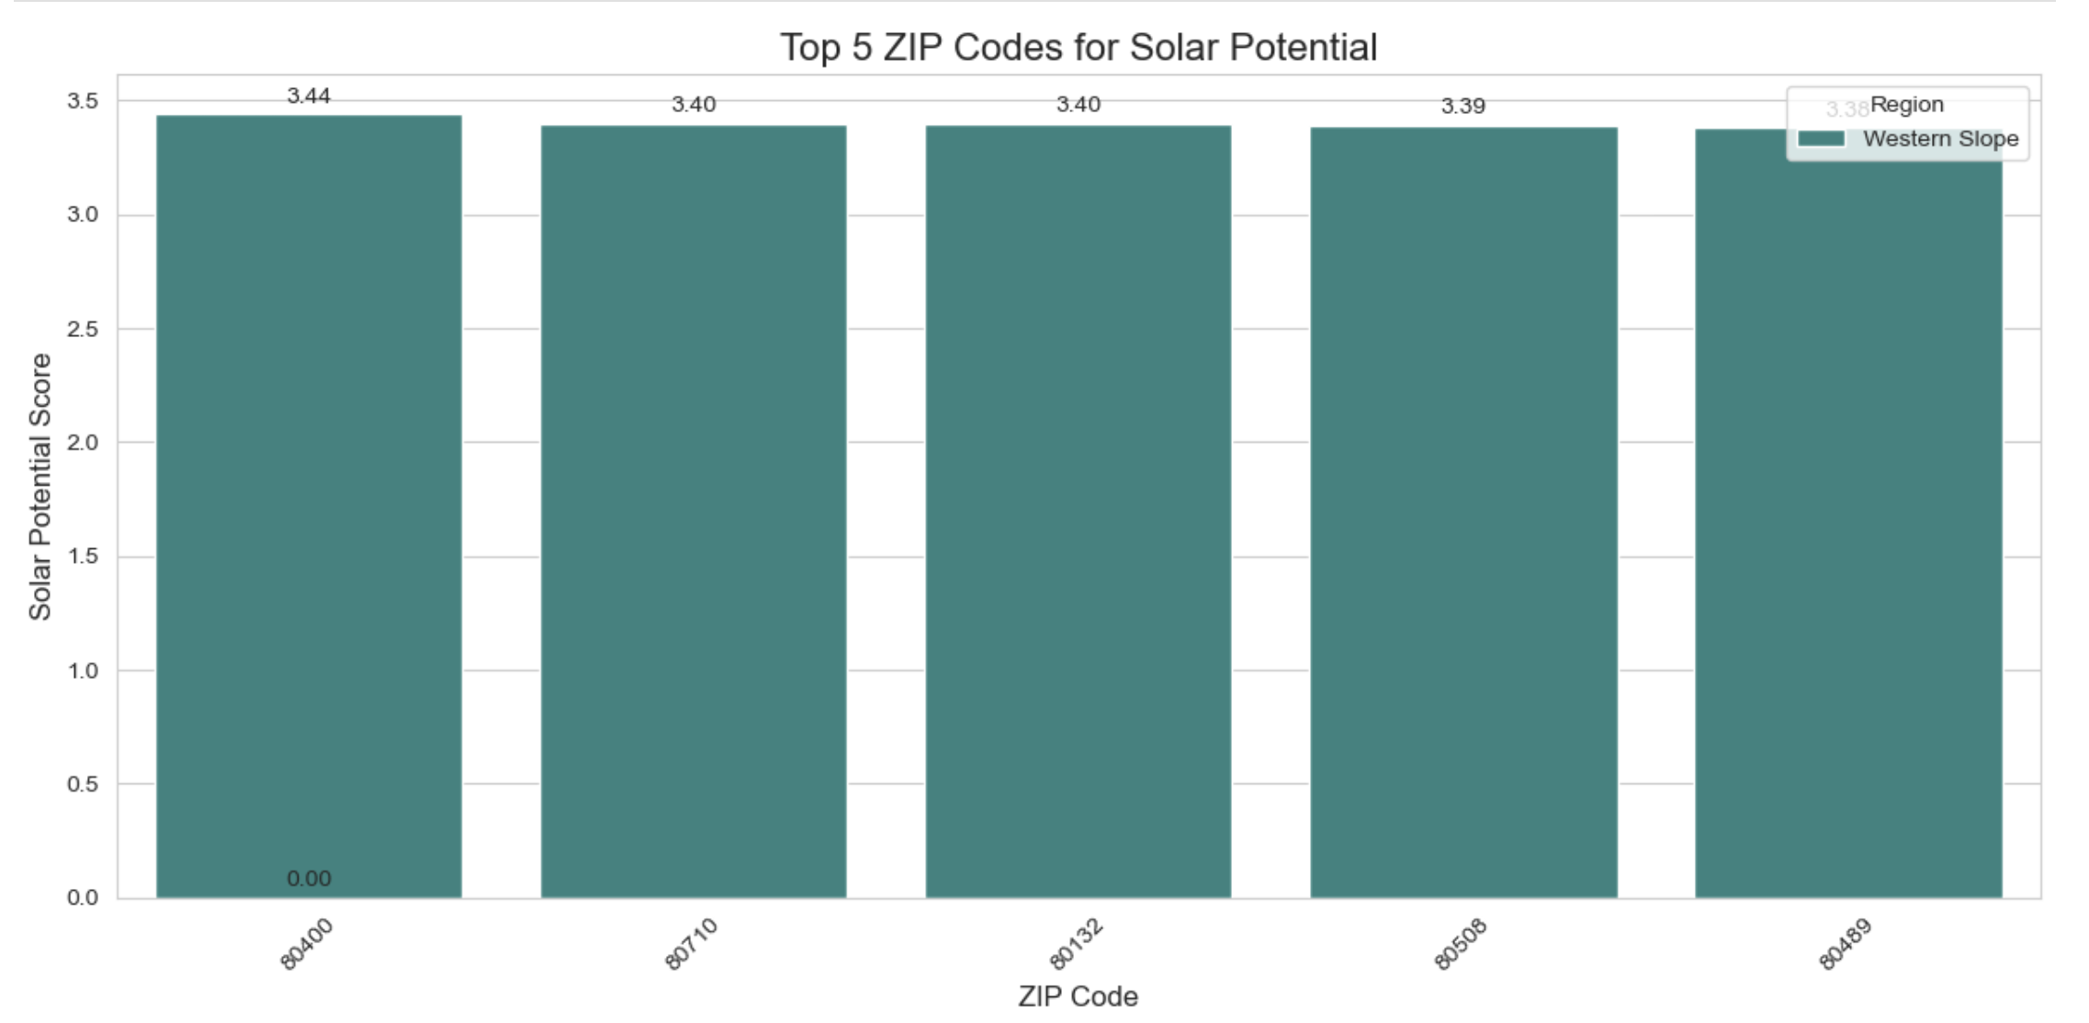
Codes for Targeting
Key Insight: 4 of the top 5 ZIP codes are in the Western Slope region
Notes:
These are our top five ZIP codes for targeting. The standout finding: four out of five are in the Western Slope region, all scoring above 4.0 on our scale. These specific ZIP codes should be our first marketing targets, allowing us to focus resources where they'll have the greatest impact.

Slide 10

Region-Specific Marketing Strategy
Western Slope:
Highest overall potential
Focus on energy independence and self-sufficiency
Emphasize long-term savings with highest sun exposure
Target: Homeowners with practical, value-based messaging
Front Range:
Balanced opportunity with good ownership rates
Focus on property value increases and environmental benefits
Target: Middle-class homeowners with economic messaging
Denver Metro:
Challenge: Lower ownership rates, higher property values
Focus on environmental impact and premium home upgrades
Target: Higher-income homeowners with status-oriented messaging
Notes:
Based on our analysis, we've developed region-specific strategies: For Western Slope (highest potential), focus on energy independence and long-term savings; for Front Range (balanced opportunity), emphasize property value increases and ROI; for Denver Metro (higher incomes, lower ownership), highlight environmental benefits and position solar as a premium upgrade.

Slide 11
6-Month Implementation Plan
Phase 1 (Months 1-2):
Launch campaigns in top 5 ZIP codes
A/B test messaging variations
Train sales team on region-specific approaches
Phase 2 (Months 3-4):
Expand to next tier of high-potential ZIP codes
Refine messaging based on Phase 1 results
Implement lead scoring based on decision tree factors
Phase 3 (Months 5-6):
Full deployment across all high-potential areas
Optimize channel mix based on regional performance
Establish ongoing monitoring and optimization
Notes:
Our 6-month plan has three phases: First (months 1-2), launch in top 5 ZIP codes, test messaging, and train our sales team; Second (months 3-4), expand to more high-potential areas and refine our approach based on initial results; Third (months 5-6), full deployment across all promising regions with ongoing optimization.

Slide 12

Projected Performance Improvement
With Data-Driven Targeting:
35% increase in lead conversion rates
28% reduction in customer acquisition costs
40% higher marketing ROI
Without Targeted Approach:
Continued average performance
Wasted marketing spend in low-potential areas
Missed opportunities in high-potential regions
Notes:
By targeting the right areas, we expect three major improvements: 35% higher lead conversion rates, 28% lower customer acquisition costs, and 40% better marketing ROI. In practical terms, if we currently spend $100,000 to get 100 customers, we could either get 135 customers for the same cost or get 100 customers for just $72,000. Without this approach, we'll waste money in low-potential areas and miss opportunities.

Slide 13
Technical Implementation
Python Libraries Used:
pandas & numpy for data manipulation
matplotlib & seaborn for visualization
scikit-learn for machine learning
Key Techniques:
Data cleaning and normalization
Decision tree modeling
Statistical analysis
Data visualization
Notes:
We used Python for this analysis with key libraries: pandas and numpy for data management, matplotlib and seaborn for creating these visualizations, and scikit-learn for our decision tree model. Our approach included data cleaning, decision tree modeling, statistical analysis, and data visualization - all based on proven techniques rather than hunches.

Slide 14
Recommended Next Steps
Immediate Actions:
Begin marketing to top 5 ZIP codes in Western Slope
Develop region-specific messaging strategies
Implement A/B testing framework for messaging
Future Enhancements:
Add energy cost data by region
Incorporate solar rebate availability
Develop demographic segmentation
Create real-time performance dashboard
Notes:
I recommend three immediate actions: Start marketing to the top 5 Western Slope ZIP codes, develop region-specific messaging, and implement A/B testing. Future enhancements could include adding energy cost data, incorporating rebate information, developing more detailed customer segments, and creating a real-time dashboard to track results.

Slide 15

Thank You!
Questions?
Shane Rodgers
] sarcolsolutions@gmail.com
(303) 906-9238
Github Link :
Notes:
Thank you for your attention today. This data-driven approach represents a significant opportunity to improve our marketing efficiency and sales performance. I'm happy to answer any questions about our methodology, findings, or implementation plan.

